Slide 1
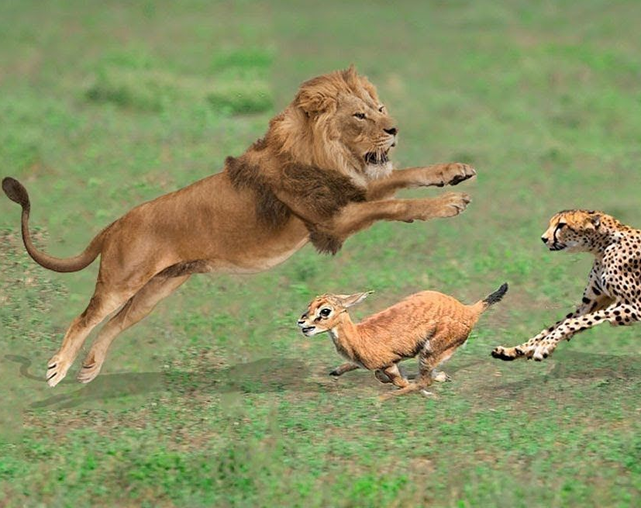
Lotka Volterra Equations
Lucas Barnes & Jacob Christensen

Slide 2
Motivation
Learn more about the relationship between predator and prey through this model

Slide 3
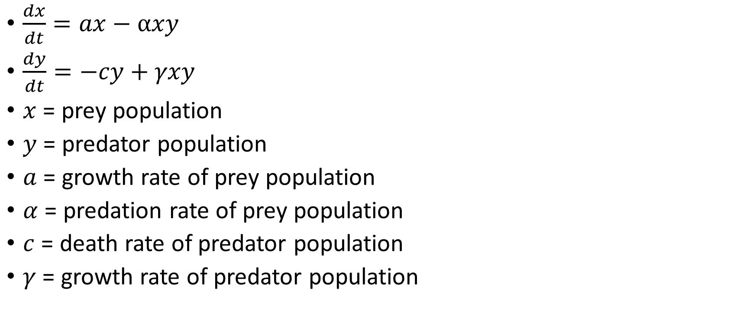
Physical System
$\frac{dx}{dt}=ax−αxy$
$\frac{dy}{dt}=−cy+γxy$
$x$ = prey population
$y$ = predator population
$a$ = growth rate of prey population
$α$ = predation rate of prey population
$c$ = death rate of predator population
$γ$ = growth rate of predator population

Slide 4
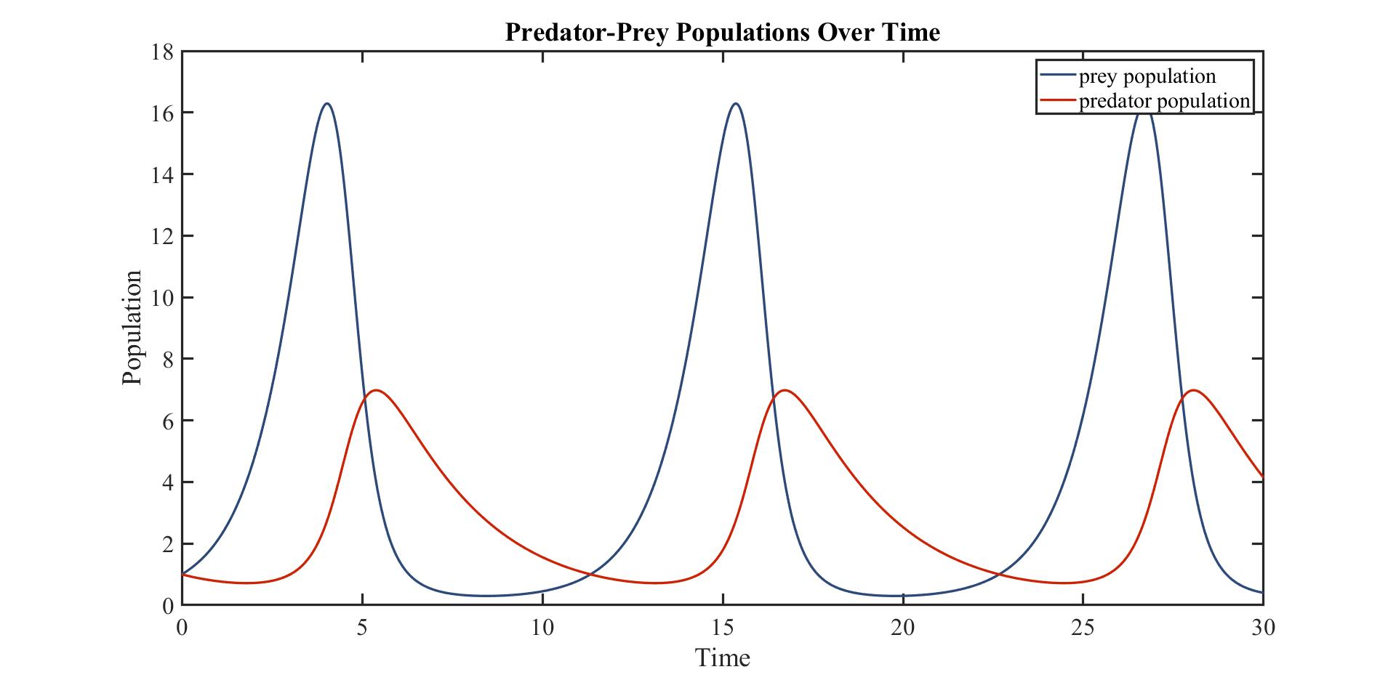

Slide 5
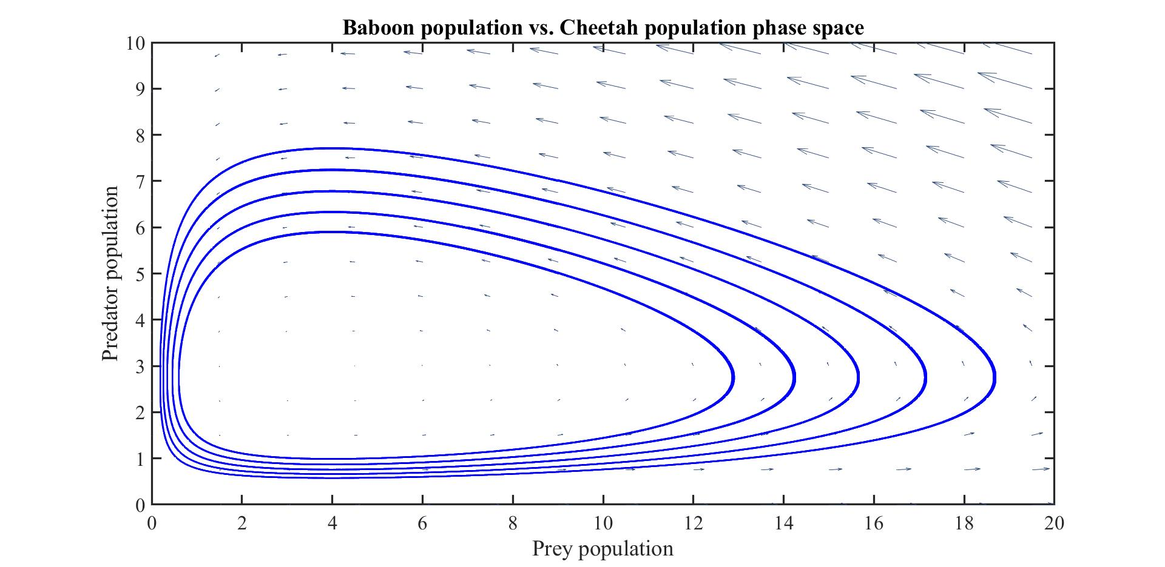

Slide 6

Environmental Factor
$\frac{dx}{dt}=ax−rx^{2}−αxy$
$r$ = environmental factors constant
Notes:
The previous plots were idealized

Slide 7
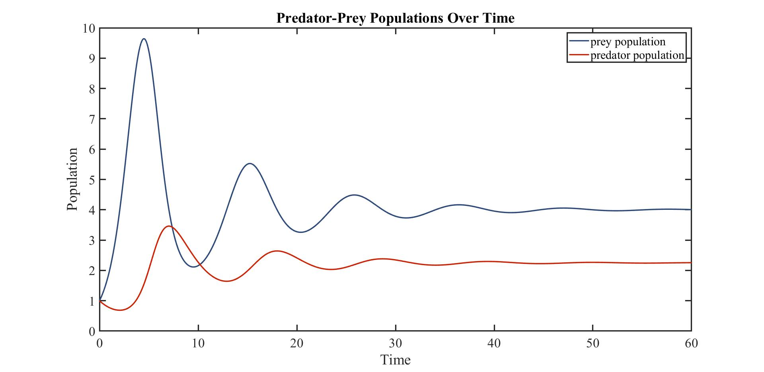

Slide 8
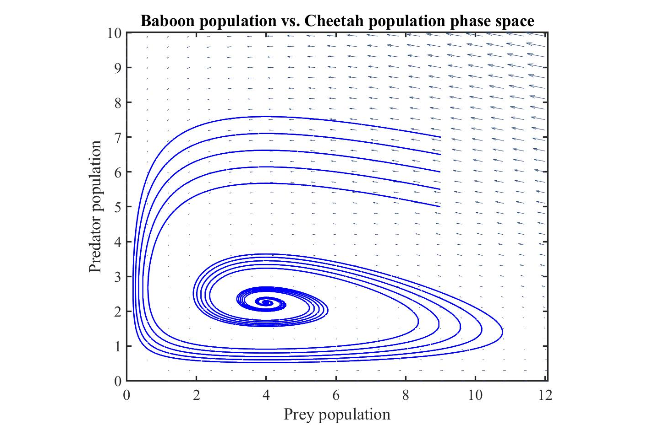

Slide 9

Equal Populations Equilibrium
$y=x=c\left(r+α\right)=aγ$
Predator death rate
Prey death rate
Predator growth rate
Prey growth rate

Slide 10
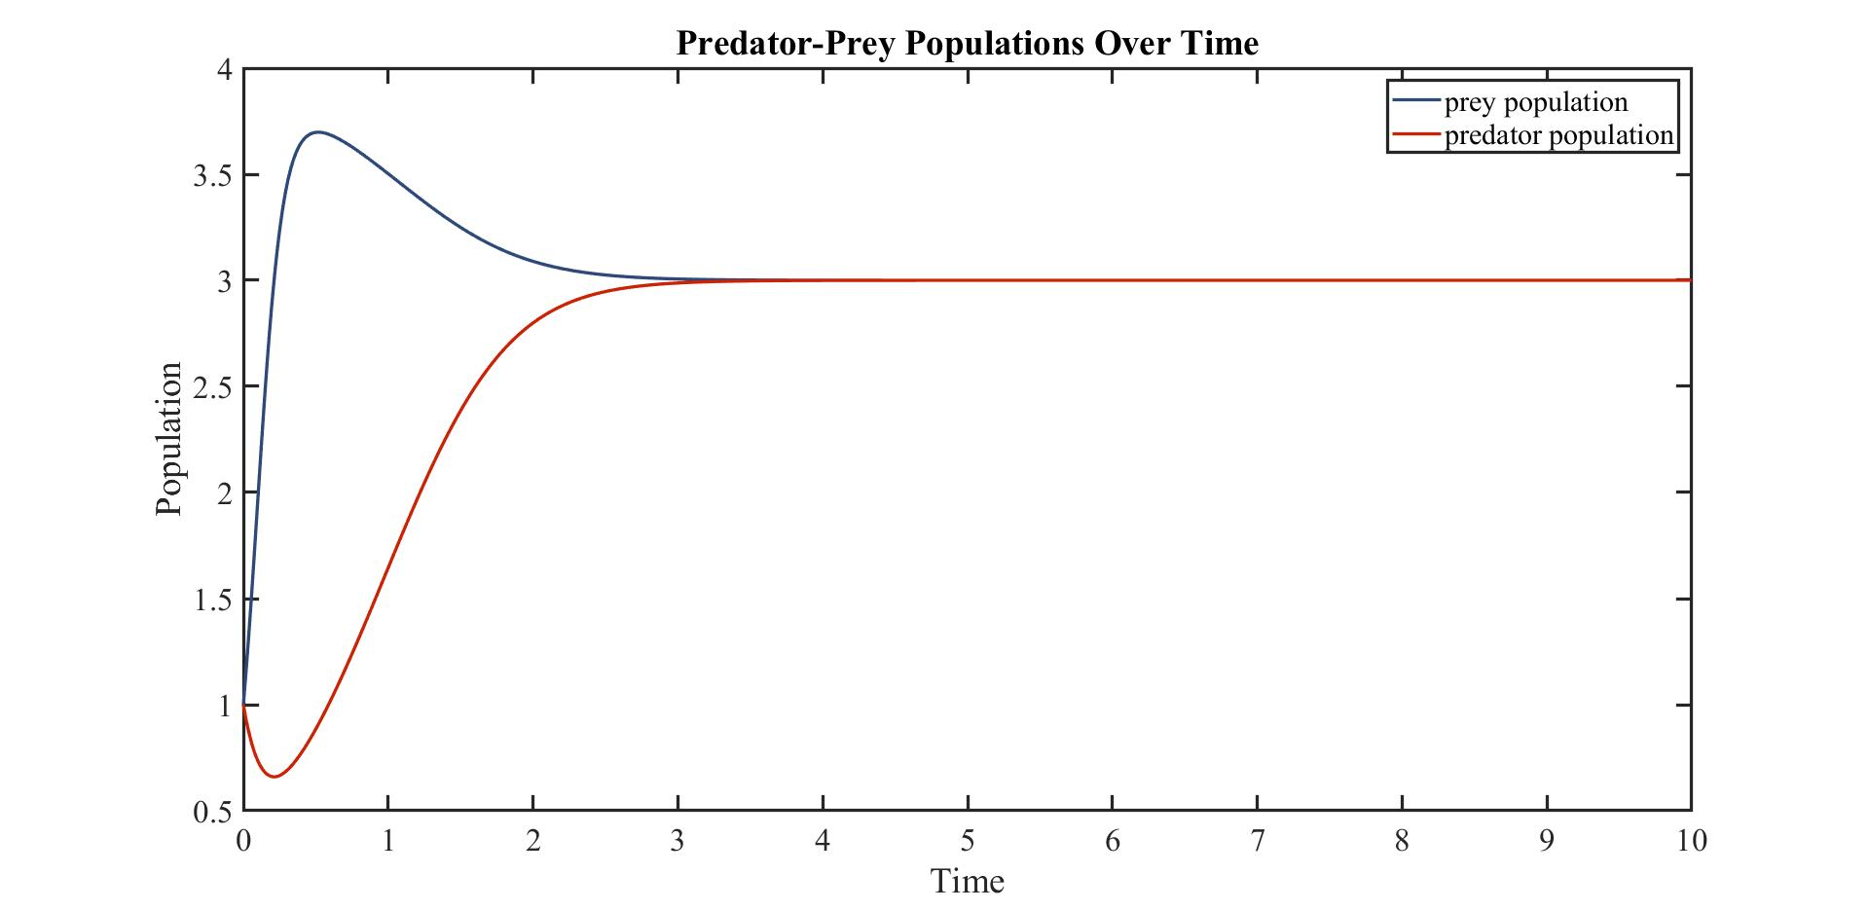

Slide 11
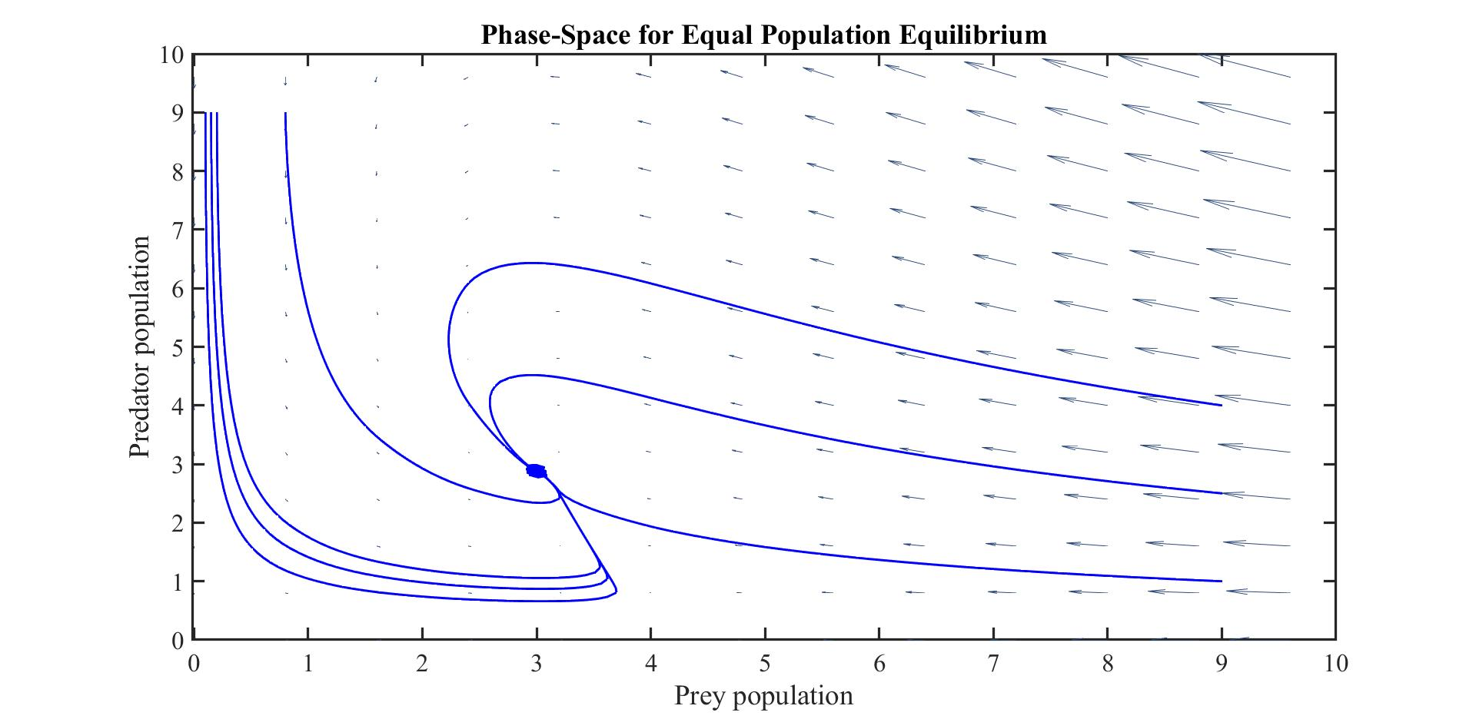

Slide 12
References
"The Predator Prey Equations“, PSU, http://www.personal.psu.edu/sxt104/class/Math251/Notes-Predator-Prey.pdf
"Lotka Volterra Equations", Wikipedia, https://en.wikipedia.org/wiki/Lotka%E2%80%93Volterra_equations

